Slide 1
Dynamic Ambient Lighting
with Harman Pulse 2

Slide 2
What
Implementation of Ambient Lighting for portable devices using Harman Pulse technology
Get Ambient Light on the go for any content your are watching on your laptop
Uses Harman Pulse 2 display capabilities
Works with one or multiple speakers simultaneously
Automatic brightness adjustments using luminescence sensors and flowthings.io API

Slide 3
Why
Ambient Lighting creates a more immersive viewing experience
Right now it is only available as part of certain high-end TVs or as a separate device
Get it on the go, you only need a laptop and a speaker
Get it without any additional devices, just software

Slide 4
Demo
Live

Slide 5
Demo
Dark Room

Slide 6
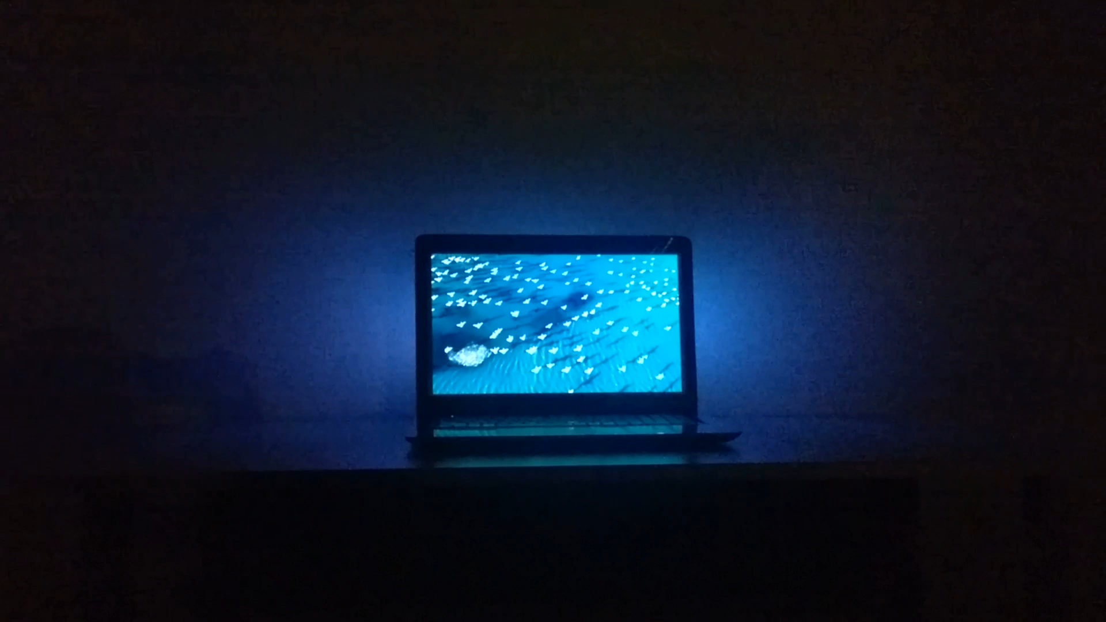

Slide 7
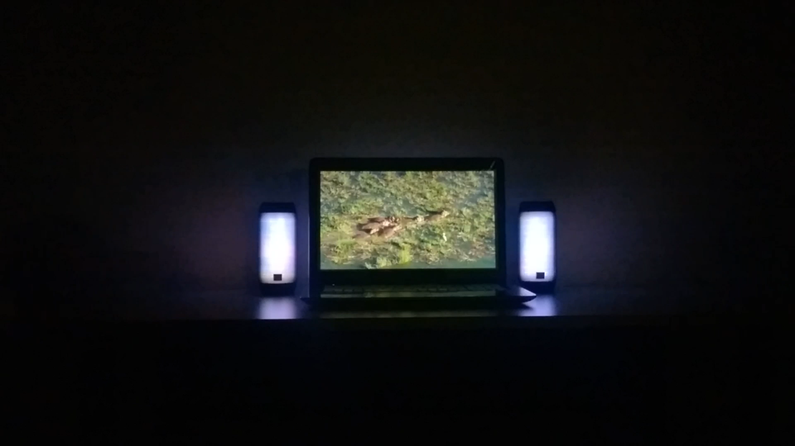

Slide 8
Demo
Flowthings.io integration

Slide 9
How
Device
control
Additional Speaker(s)
pairing
Main Speaker
control
lux json
flowthings.io
control
image and brightness control
sound
luminescence data
lux

Slide 10




Processing flow
22x9
11x9
11x9

Slide 11
What’s next
New effects
Smarter filters (blur)
Harman SDK for .NET (open source)

Slide 12
Questions

